Slide 1
AN EFFICIENT PROCESSING OF SPATIO TEMPORAL AGGREGATE QUERIES
PRESENTATION BY
FARHANA A REHIM
ROLL NO: 218

Slide 2
TABLE OF CONTENT
SL NO | CONTENT
1 | KEY POINTS
2 | INTRODUCTION
3 | RELATED WORK
4 | GAP IDENTIFIED
5 | OBJECTIVE
6 | PROJECT SCHEDULE
7 | METHODOLOGY
8 | DATABASE
9 | DATASET
10 | CONCLUSION
11 | REFERENCE

Slide 3
KEY POINTS
A moving object refers to an object or entity that changes its position over time. It could be a physical object such as a car, a bird, or a person.
A moving object at time t can be represented in the form O(id, x, y, t). The coordinates (x, y) indicate latitude and longitude of the moving object and t is the time in which the object resides the location (x, y). The position (x, y) is called spatial component and ti is its temporal component.
A trajectory is a sequence of points or positions that describe the movement of a moving object over time.A trajectory is a representation of a moving object, which is typically stored as a series of points with timestamps.
Semantic properties are contextual information of the moving object trajectories.These information comprise of the direction of movement, the velocity of the object, stop points etc.

Slide 4
INTRODUCTION

Slide 5
The recent advancement in positioning, telemetry and telecommunication technologies, and with wide availability of devices that produce information about the position of an object in some time, amount of data is generated.
A moving object query, also known as a spatiotemporal query, is a query used to retrieve information about objects that have a specific location and are moving over time. These queries can be used to track the movement of vehicles, people, or other objects that are equipped with GPS or other location-tracking devices.
Querying and analyzing of this data can give us can give more inference on the mobility pattern of the objects.

Slide 6
Applications modelling spatio-temporal objects need to process vast amount of data.Therefore in our project we are proposing a method for evaluvating spatio temporal data using aggregate queries.
Staying point detection is the process of identifying locations where an object has remained stationary for a period of time or a point where two vehicles met at the same time etc. These points can also be called as “point of interest”.
Aggregate queries are used for generating aggregate information from the data set which is more useful than individually analyzing every entry.
For the effective processing of queries continuous clustering is employed on moving objects.
We prove that our system can deliver answer to spatio-temporal aggregate queries effectively without processing the entire records of the moving objects.

Slide 7
RELATED WORK

Slide 8
RELATED WORK
SL NO | TITLE OF THE PAPER,JOURNAL NAME,PUBLISHER,YEAR | PROS OF THE PAPER | CONS OF THE PAPER
1 | A Taxonomy for Moving Object Queries in Spatial Databases-Sultan Alamri,David Taniar (2014) | Provides a clear and organized structure for understanding different types of moving object queries | The taxonomy may be too broad or too specific, and may not capture all the possible types of moving object queries
2 | Spatiotemporal Aggregate Computation: A Survey-Richard Snodgrass,Bongki Moon,Ines Fernando Vega Lopez | Helps researchers and practitioners understand the state-of-the-art techniques and methods for handling large datasets of moving objects | The survey may oversimplify or overlook important aspects of spatiotemporal aggregate computation, leading to incomplete or inaccurate understanding of the field.
3. | A foundation for representing and querying moving objects-Ralf Hartmut Guting,Michael H Bohlen,Martin Erwig (2003) | Supports querying of complex spatial and temporal relationships between objects. Enables integration with other databases and data sources. | Can be computationally expensive to process and query large amounts of data.

Slide 9
GAP IDENTIFIED
Moving objects are points that change their locations over time , which requires a higher update frequency. With the development of tracking and positioning systems, such as GPS, the correct recording of locations has become available which results in database being flooded with data from various sources.
It is difficult to process this entire data due to limitations of system resources in terms of space and time.
Querying of moving object data is very complex therefore it can be computationally expensive.
Inorder to solve the above stated issues we propose a method which help to retreive information without processing the entire data of moving object.

Slide 10
OBJECTIVE
The main objective is to propose a system that helps to process moving object data without processing the entire record.
To propose a system that reduces the complexity and time for processing the data.
To implement a model that forms cluster based on the density of points within the specific region.
To develop a system that provides aggregate values of the data based on specific queries.

Slide 11
PROJECT SCHEDULE
 | JANUARY | FEBRUARY | MARCH | APRIL
INFORMATION GATHERING & ANALYSIS
DESIGN
DEVELOPMENT
TESTING
DOCUMENTATION

Slide 12
METHODOLGY

Slide 13
1. STAYING POINT DETECTION
Staying point detection is a process used to identify locations where an object has remained stationary for a period of time. This is typically done by analyzing the GPS data of the object, which includes information about the object's location, speed, and direction of movement.
There are several algorithms that can be used for staying point detection.Some of these algorithms are:
1.Grid-based
2. DBSCAN
3.ST-DBSCAN
4.HT-DBSCAN
    Staying point detection can be done in different granularity levels, for example, you can detect staying points at the street level, city level, or even country level. The granularity level affects the precision and recall of the detection.

Slide 14
2. DBSCAN (Density-Based Spatial Clustering of Applications with Noise)
The basic idea behind DBSCAN is that clusters are dense regions of points that are separated from each other by areas of lower point density.
The algorithm uses two parameters, eps and MinPts, to define the clusters. Points are considered as staying points if they are in a dense region and not on the border of a cluster.
The eps parameter defines the maximum distance between two points that are considered to be in the same cluster.
The MinPts parameter defines the minimum number of points that must be present in a cluster for it to be considered a valid cluster.
To summarize the algorithm starts by selecting an arbitrary point and checking its neighborhood to see if it has at least MinPts points within a distance of eps. If it does, the point is considered a core point and a new cluster is created.

Slide 15
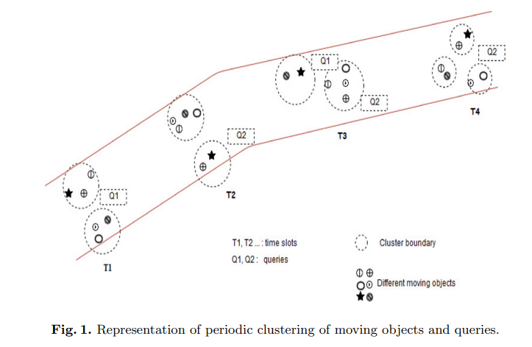
The algorithm then continues to expand the cluster by adding points that are within eps distance of the core points while making sure that the density of points in the cluster is above a certain threshold.

Slide 16
3. AGGREGATE QUERIES
Applications modeling spatio-temporal objects need to process vast amounts of data. In such cases, generating aggregate information from the data set is more useful than individually analyzing every entry.
Aggregate queries are used to perform calculations on data stored in a database, such as counting, summing, averaging, and finding the minimum or maximum value.
Few spatio temporal aggregate queries that are commonly used :
1.Counting the number of objects within a specific spatial region at a given point of time.
2.Summing the total distance covered by all objects within a specific spatial region over a given period of time.
3.Averaging the speed of all objects within a specific spatial region over a given period of time.

Slide 17
Example:
Get total number of objects traveled between loc1 and loc2 during time1 and time2
SELECT COUNT(*) FROM clus_ds as c WHERE c.tim BETWEEN t1 and t1 AND c.location BETWEEN loc1 AND loc2
Average speed of objects traveling between loc1 and loc2 in next t seconds
SELECT AVG(duration) FROM clus_ds as c WHERE c.location BETWEEN loc1 AND loc2 UNTIL c.curr_time + t

Slide 18
SPATIO TEMPORAL DATABASE

Slide 19
A spatio temporal database or moving object database (MOD) is a type of database that is specifically designed to store and manage data about moving objects, such as vehicles or people.
These databases typically use spatiotemporal data, which combines information about the location and movement of objects over time. This allows for efficient querying and analysis of data such as the current location of an object, its past movements, and its predicted future movements. Example is migratory patterns of bird are changing, Antartica iceberg are decreasing etc.

Slide 20
Another important aspect of MODs is their ability to handle large amounts of data. As the number of moving objects increases, so does the amount of data that needs to be stored and processed. MODs are designed to handle this scale by using techniques such as indexing, partitioning, and compression.
The spatio temporal data is stored in the form of points, lines, regions etc.
-Point is used to show a location of a particular object (like- school, building).
-Lines show linear features, such as streets, rivers, and roads etc.
-Polygon composed of bounding arcs and label points shows the boundary of a city, forest.

Slide 21
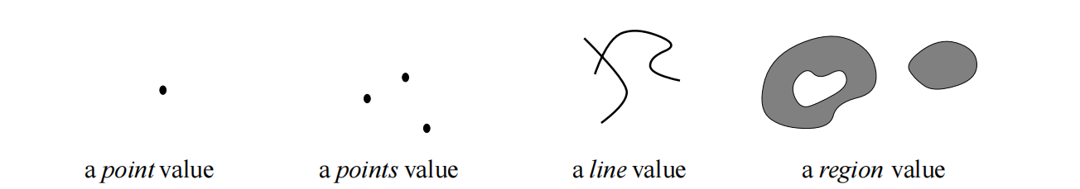
The spatio temporal data can be in 2 forms −
Moving point - Only the location of the data point matters and not its size or extent. Example - The location of an airplane at any given moment.
Moving region - The location of the region as well as its size and extent matters as the region may reduce or increase with time. Example - The location and size of a hurricane as it travels across the country.

Slide 22

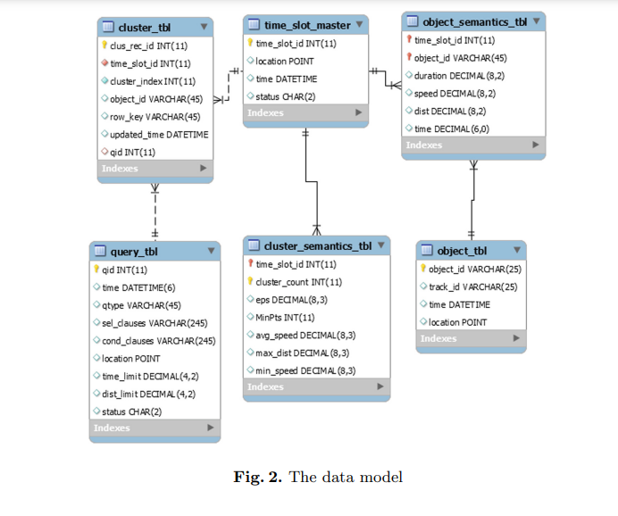

Slide 23
DATASET
The dataset used for the project is:
Geolife GPS trajectory dataset :This GPS trajectory dataset was collected in (Microsoft Research Asia) Geolife project by 178 users in a period of over four years (from April 2007 to October 2011). A GPS trajectory of this dataset is represented by a sequence of time-stamped points, each of which contains the information of latitude, longitude and altitude. This dataset contains 17,621 trajectories with a total distance of 1,251,654 kilometers and a total duration of 48,203 hours.
TDrive Trajectory Dataset :It contains a one-week trajectories of 10,357 taxis. The total number of points in this dataset is about 15 million and the total distance of the trajectories reaches 9 million kilometers.Each record in the trajectory consists of latitude, longitude, altitude and temporal information of the moving objects.

Slide 24
CONCLUSION
Clustering and querying of moving object data is gaining more momentum as an area of research due to the generation of huge spatial temporal data from wide range of location sensing devices.
We are proposing a system that helps in effective processing of spatio temporal aggregate queries.
Our method helps to effectively answer spatio temporal aggregate queries with the help of staying point detection and clustering process.
The model saves time and money since we need not process the whole data each time which reduces the complexity of the process.

Slide 25
REFERENCE
A.Nishad.,Sajimon. Abraham.: A Method for Continuous Clustering and Querying of Moving Objects,Springer Nature Singapore Pte Ltd, A. K. Luhach et al. (Eds.): ICAICR 2019, CCIS 1075, pp. 172–183, 2019. https://doi.org/10.1007/978-981-15-0108-1_17
M. A. Hernandez et al.: A Foundation for Representing and Querying Moving Objects :IEEE Transactions on Knowledge and Data Engineering, vol. 15, no. 6, pp. 1493-1517, 2003.
"Moving Object Queries: A Survey" by N. K. Dhar and D. K. Nehab, IEEE Transactions on Knowledge and Data Engineering, vol. 19, no. 7, pp. 936-957, July 2007.
"Efficient Algorithms for Moving Object Queries" by C. G. Xia and J. Han, IEEE Transactions on Knowledge and Data Engineering, vol. 16, no. 5, pp. 603-619, May 2004.
"Continuous and Discrete Moving Object Queries in Spatial Databases" by A. K. S. Kumar, P. S. S. Kumar, and J. L. Harmon, IEEE Transactions on Systems, Man, and Cybernetics, Part A: Systems and Humans, vol. 39, no. 2, pp. 267-280, March 2009.
"Moving Object Queries in Trajectory Databases" by Y. Pan, J. Pei, J. Han, and P. S. Yu, IEEE Transactions on Knowledge and Data Engineering, vol. 21, no. 5, pp. 712-725, May 2009

Slide 26
THANK YOU

